Slide 1
Nonparametric Scene Parsing

Slide 2
Baseline System
Nonparametric scene parsing
Image retrieval
Image segmentation
Label transfer

Slide 3
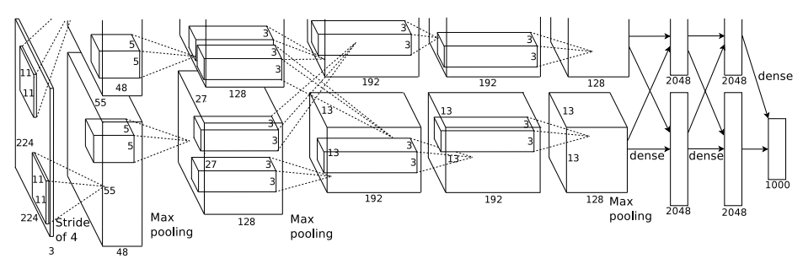
Image Retrieval
Retrieve similar image
Caffe CNN feature (7th layer) [KSH12]
Euclidean distance
Retrieve 40 images
7
A. Krizhevsky, I. Sutskever, and G. E. Hinton. ImageNet classification with deep convolutional neural networks. In NIPS, 2012.

Slide 4
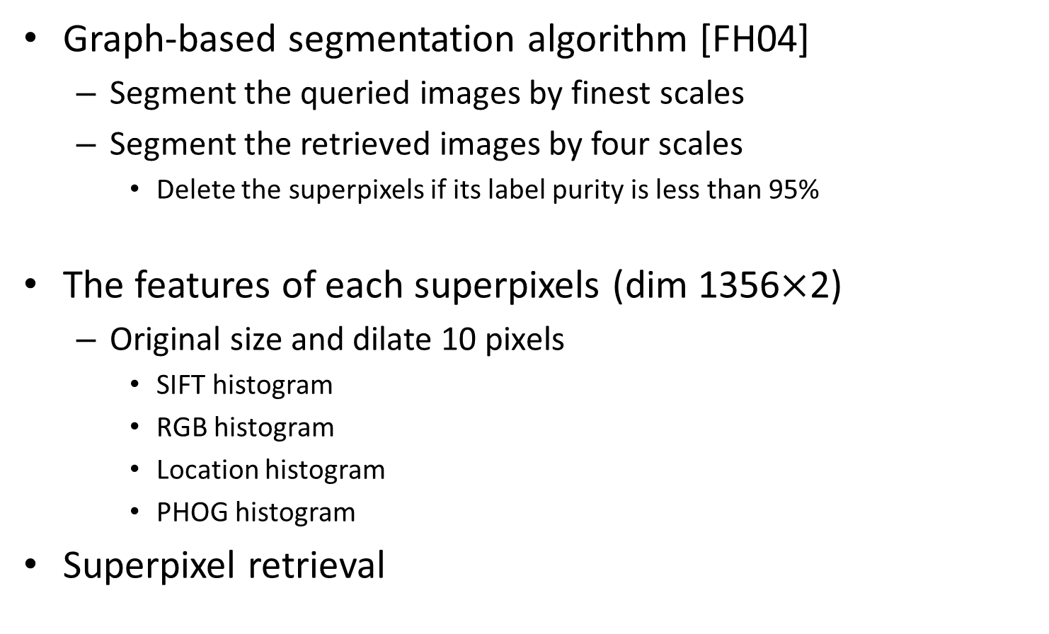
Image Segmentation
Graph-based segmentation algorithm [FH04]
Segment the queried images by finest scales
Segment the retrieved images by four scales
Delete the superpixels if its label purity is less than 95%
The features of each superpixels (dim 1356$×$2)
Original size and dilate 10 pixels
SIFT histogram
RGB histogram
Location histogram
PHOG histogram
Superpixel retrieval
P. F. Felzenszwalb and D. P. Huttenlocher. Efficient Graph-Based Image Segmentation. IJCV, 59(2), 2004.

Slide 5

Label Transfer
Label Transfer
Four-connected pairwise MRF model
Alpha-beta swap algorithm [BVZ01]
Energy Function:
Adjacent pixels: p, q
Class : c
Unary energy
Label cost
Y. Boykov, O. Veksler, and R. Zabih. Fast approximate energy minimization via graph cuts. PAMI, 23(11):1222 – 1239, 2001.

Slide 6
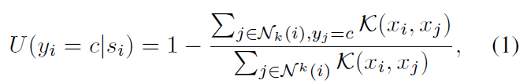

Label Transfer
Energy function:
Unary energy
Spatially variant label cost
Unary energy
Label cost
Intersection
Color similarity
Label co-occurrence statistics

Slide 7
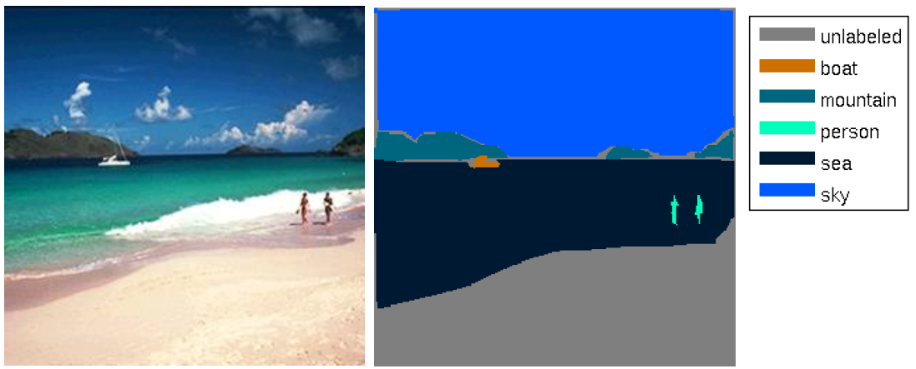

Dataset
SIFT Flow
2688 images (256$×$256)
33 classes

Slide 8
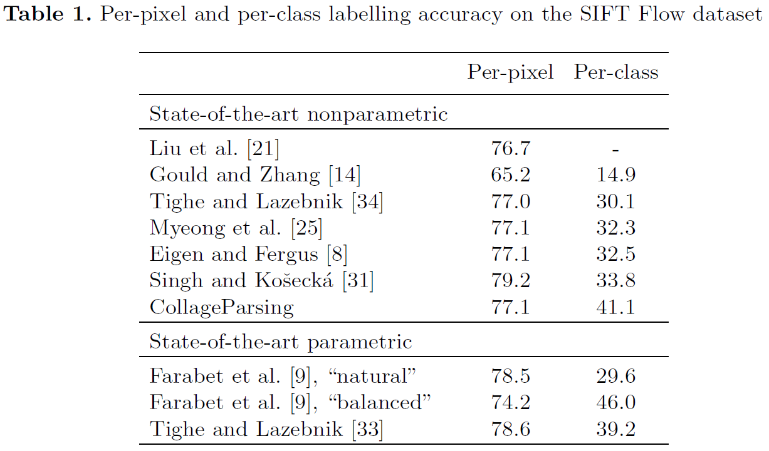
Experiments
[TL14] Sift Flow dataset
[TL14]
[YPCY14] (non-para) 79.8 48.7
J. Yang, B. Price, S. Cohen and M.Yang. Context driven scene parsing with attention to rare classes. In CVPR, 2014.
F. Tung and J. J. Little. CollageParsing: Nonparametric scene parsing by adaptive overlapping windows. In ECCV, 2014.
[33] J. Tighe and S. Lazebnik. Finding things: Image parsing with regions and per-exemplar detectors. In CVPR, 2013.

Slide 9
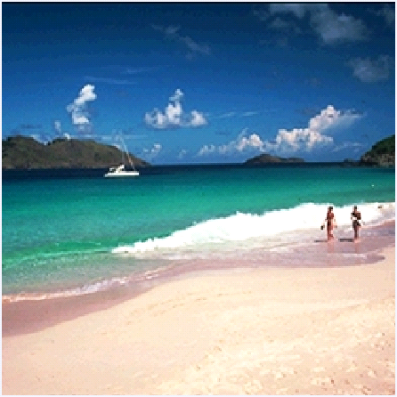
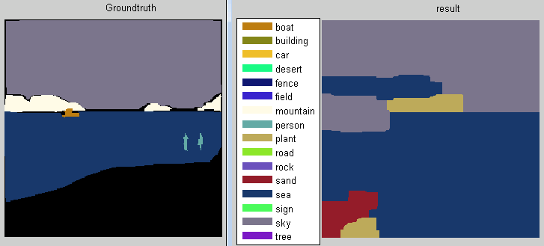
Result
perPixel accuracy = 81.47%

Slide 10
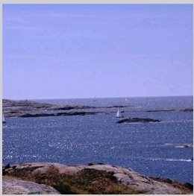
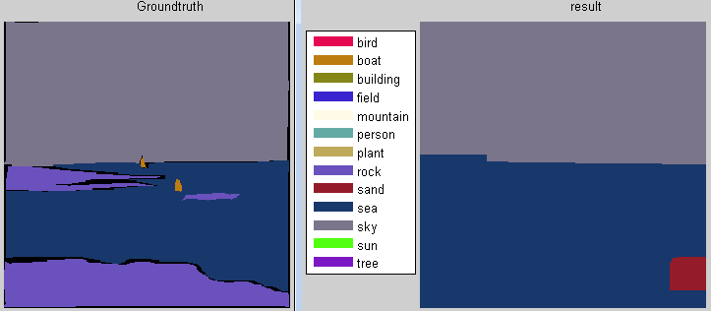
Result
perPixel accuracy = 80.63%

Slide 11
Runtime
Parse one image (~60sec)
Image retrieval < 1sec
Load/ retrieval superPixels ~10sec
Solve the MRF model ~50sec

Slide 12
Future Work
Rare class expansion
Image segment
Winodws (objectness measure)
The feature of Segment
R-CNN feature

